Slide 1
IT Capstone group Project
Issa’s Events Project Proposal

Slide 2
Group members
Jennifer Sanchez
Yadriel Quinones Sustache
Paul Intriago Troya
Connor Cowles
Jonathan Wesley

Slide 3

Onboarding/Offboarding project- Issa’s events
Start-up with 25 employees
Projected to double head-count within a year
Requires immediate IT consulting
  Framework and external IT pipeline
Investor funded
  $25,000
Dec 4th deadline

Slide 4
Core problem
Delayed onboarding, missed tasks
Vendor and financial security risks
Disorganized Technical Support

Slide 5
Proposed solution
Automated onboarding – Auto assign emails, onboarding checklists, issue hardware, assign licences and user role
Dashboard showing onboard/offboard status
Instant offboarding- locks access to sensitive information
Inventory tracking
Outsourced helpdesk
Phase 1
Requirements and Planning
Phase 2
Requirements and Architecture
Phase 3
Core Feature Development
Phase 5
Phase 4
Integration and Testing
Delivery and Presentation

Slide 6
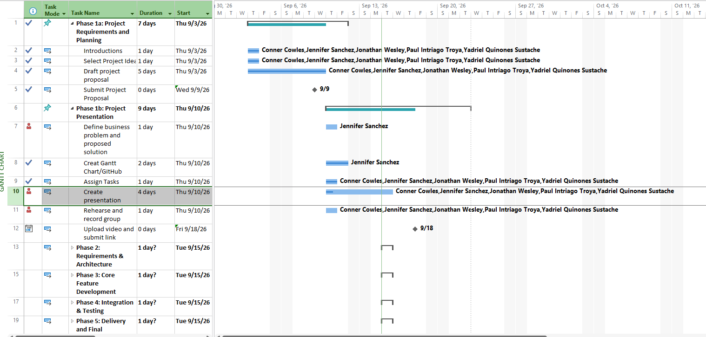
My Role
Project Manager
  Gantt chart
Support

